Slide 1

Communicate/Visual Data Analysis- ALY6070
Bike Sharing Dataset
Final Project
Group Members:
Anupreeta Mishra
Parinita Mahindrakar
Siddharth Mani
Shivani Adsar
Shraddha Gopalakrishnan

Slide 2
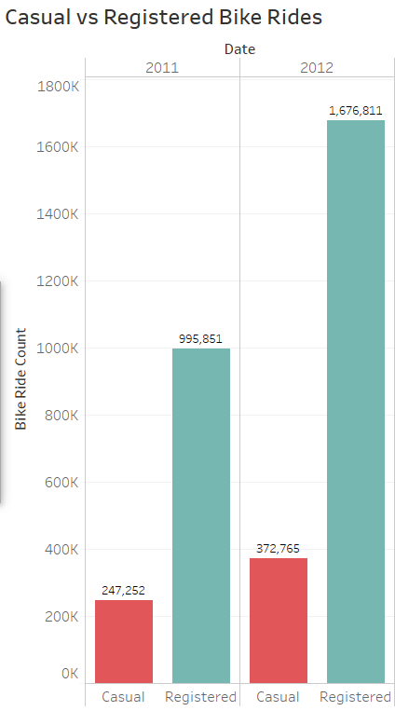
Introduction
We have the data for Bike Rentals with respect to seasons, holidays, year, weather, and registered rides in the form of a csv file.
For representation of data in the PPT we have used Tableau.
The first graph depicts whether the bike rentals are by casual or registered users and shows the count of the rides for the year 2011 and 2012.
We see that the count for 2011-2012 Casual Rides are 247,252 and 372,765 respectively. About the Registered Rides, the figures are 995.8K (2011) and 167.6K(2012).
Registered Users were responsible for around 4 times as many trips as Casual over the three months.

Slide 3
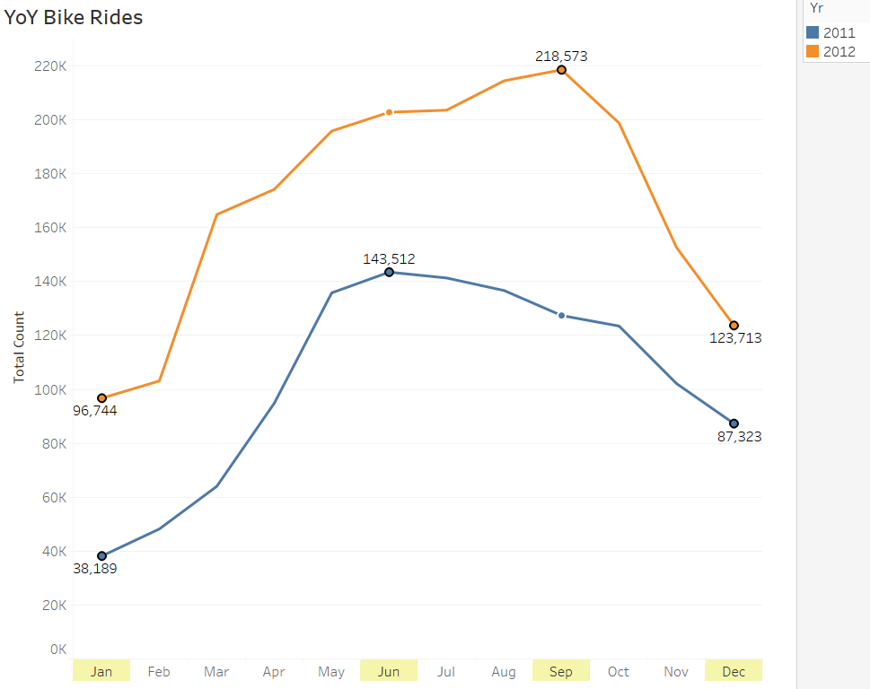
Year On Year Analysis of Bike Rides
The chart besides portrays total count of the bike rides for the highlighted months January, June, September and October with peak count of 218.5K in September.
It can be observed that in 2012 the numbers have increased than that in 2011 maybe beacause people started becoming health conscious and more aware of the environment.

Slide 4
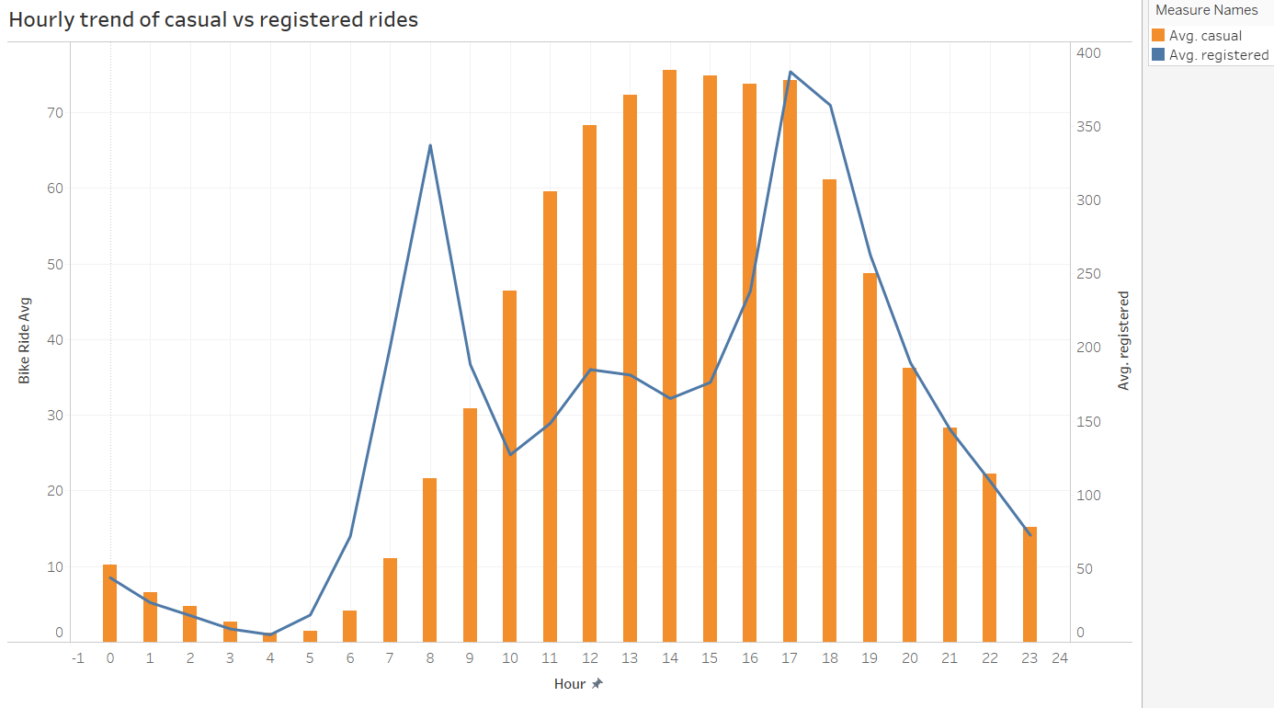
Casual vs Registered Hourly Trend
We analyze that the count for both is highest for the hour 5 PM due to nice natural light and good evening weather.
There is a peak for average registered users around 8 AM which shows these rides could be regular bikers practicing for a nearing competition.

Slide 5
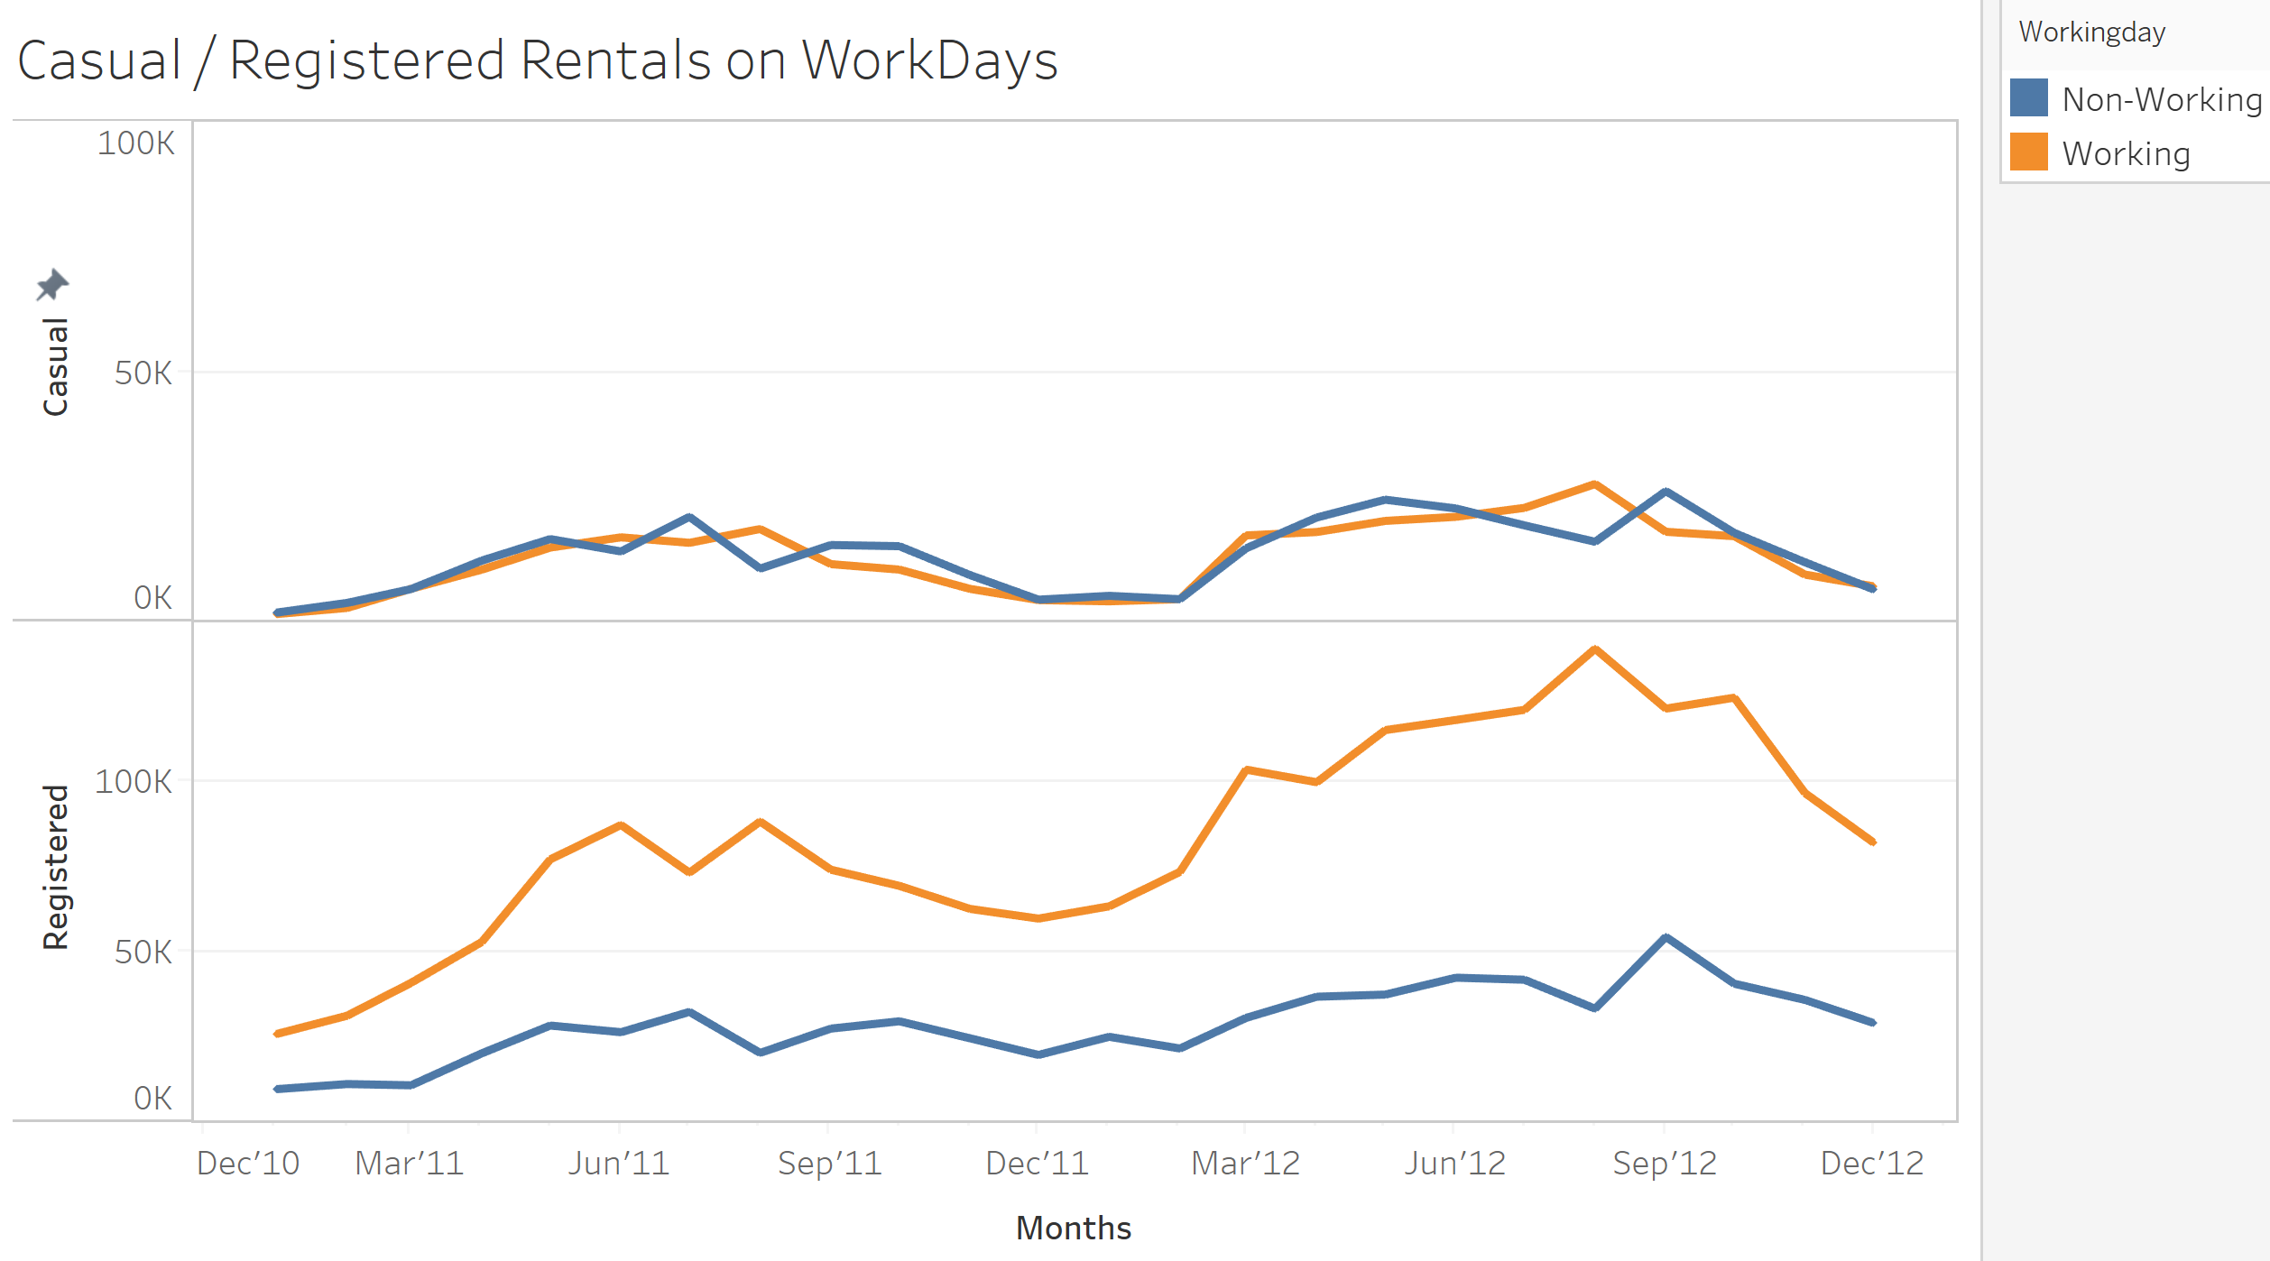
Trend Analysis
Registered users follow a seasonal pattern for working and non-working days.
As observed, the count of bike rides for casual users for working and non-working days was similar.
The count of rides on working days for registered users is higher because of a fixed routine.

Slide 6
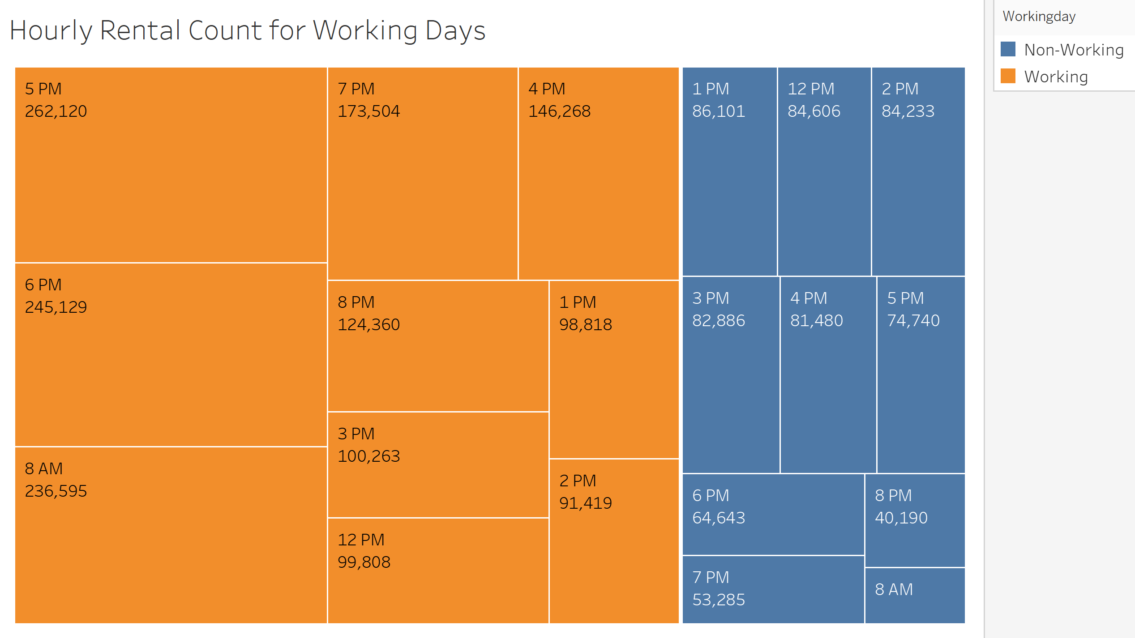
Tree Map
Maximum rentals observed in working days.
Peak hours of working days show highest count of rentals, as these are the hours during which people commuted to work from home and vice versa.
For non-working days, highest count of rentals is 12-4 PM for leisure.

Slide 7
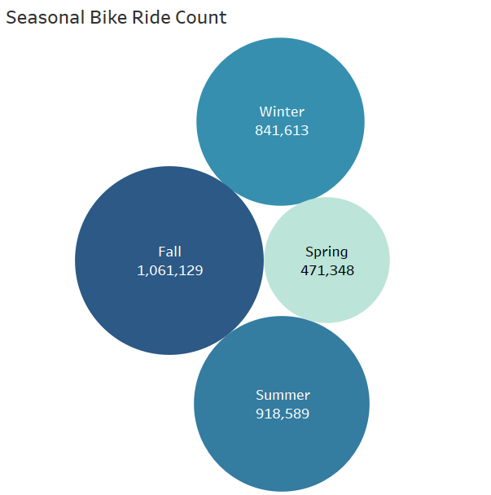
Rental Count over Season
This chart shows bike rentals for the four seasons where the darkest color indicates the highest value.
As seen from the chart, Fall is the most appropriate weather for bike rentals followed by Summer, Winter and Spring.
Fall has the maximum count with 1.06M rides and Spring with 471.3K rides has the least count.

Slide 8
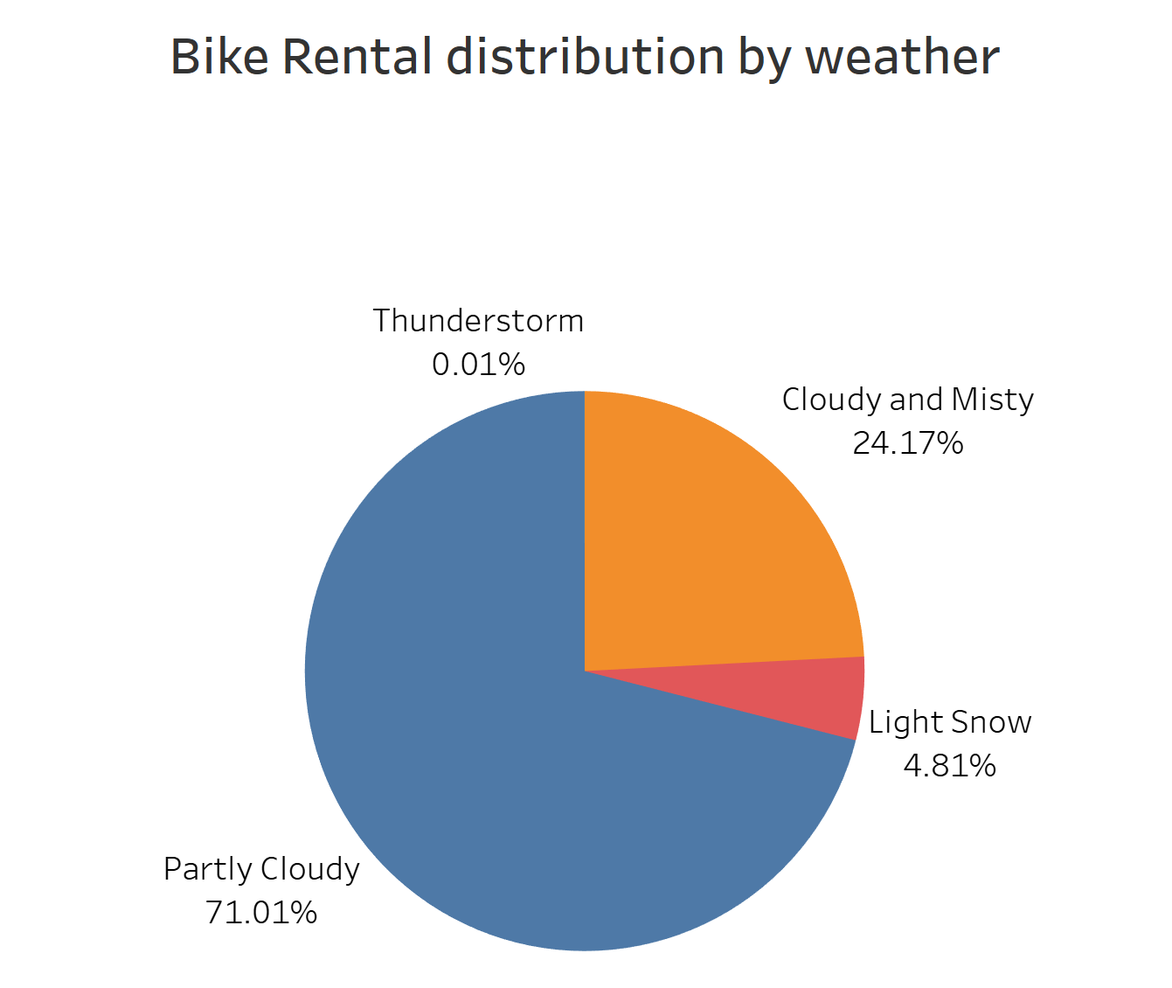
Weather Distribution
When distributing rides based on weather, we get a beautiful Pie-chart depicting percentages of ride counts during different weather.
It can be noted that 71.01% of bike rentals happen on a Partly Cloudy weather followed by Cloudy and Misty weather at 24.17%.
The obvious reason for highest bike rentals on a Partly Cloudy weather is clear vision and track conditions

Slide 9
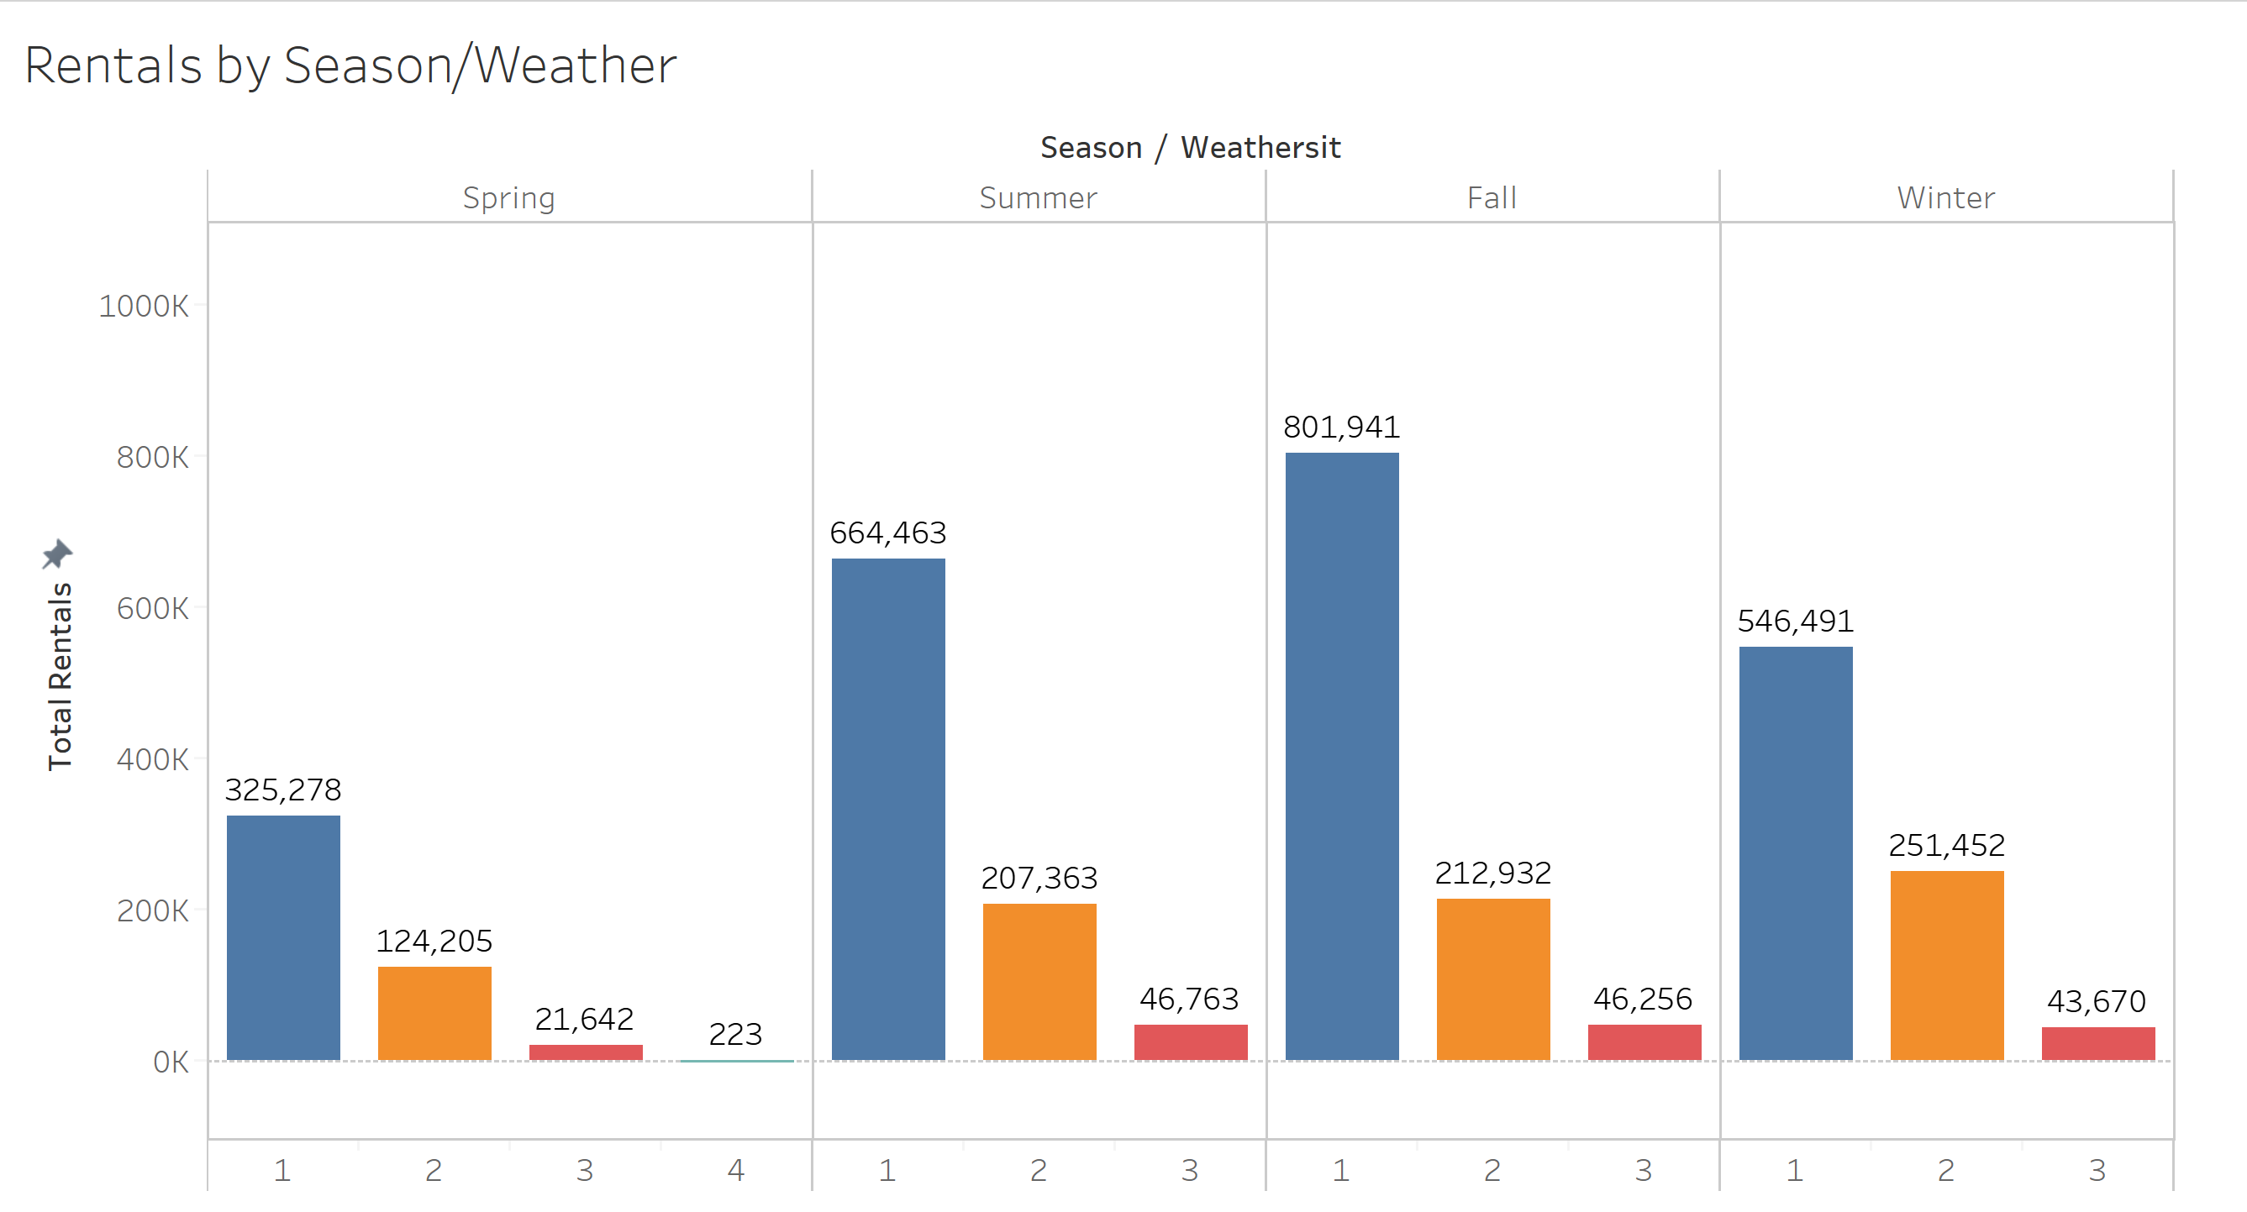
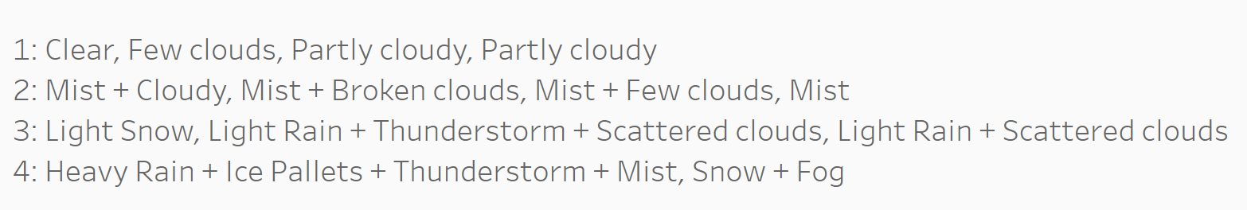
Bike Rentals by Season/Weather
Highest Rentals observed for Partly Clouded Weather followed by Mist + Cloudy and Light Snow.
Lowest Rental observed in Spring for Thunderstorm.
Clear weather during Fall season had the maximum number of Bike Rentals.

Slide 10
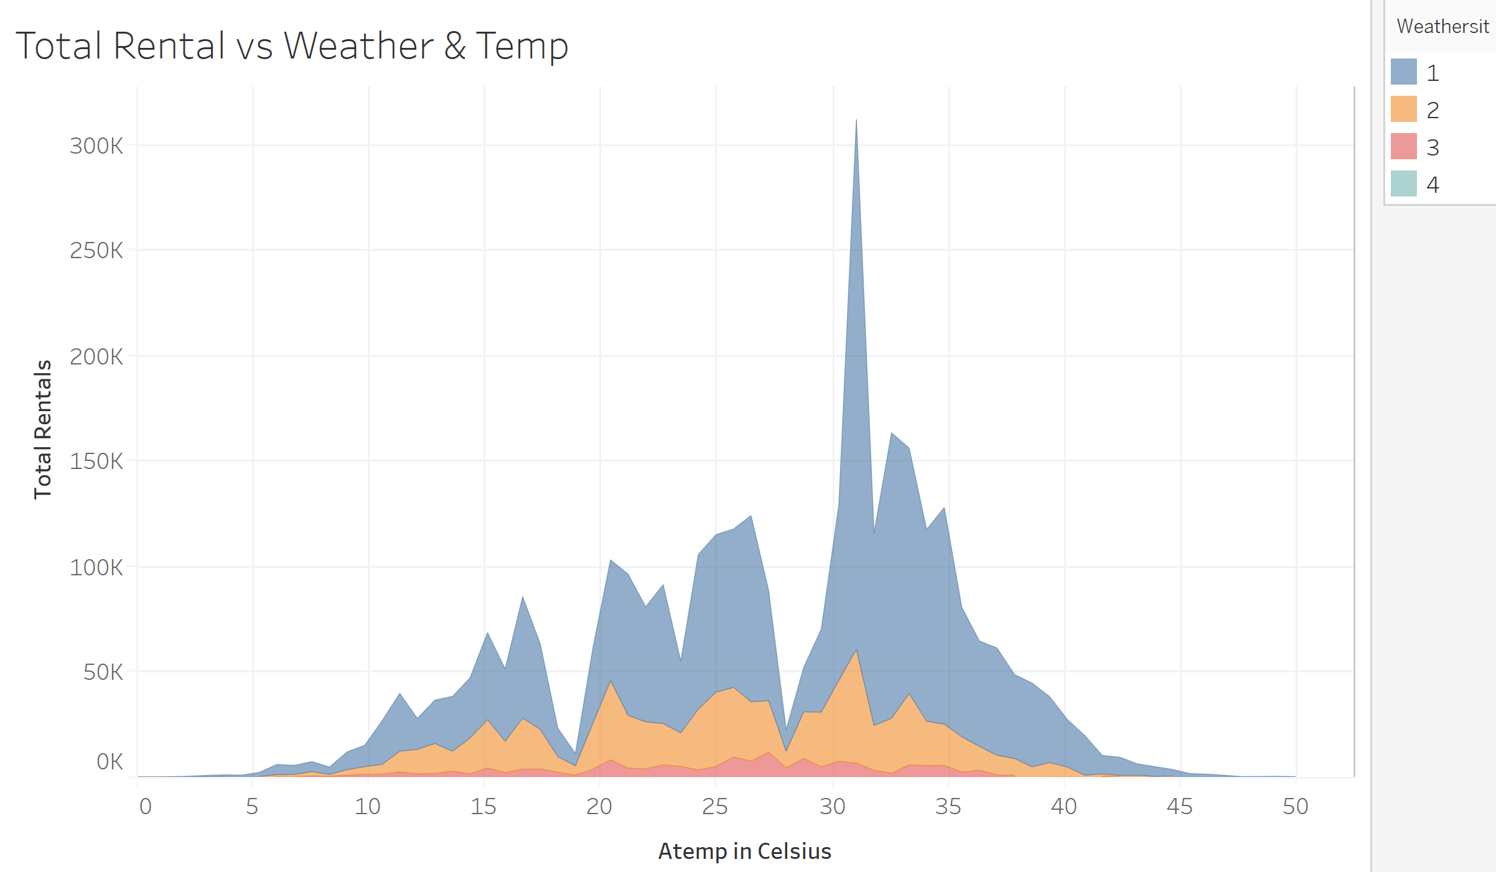
Weather & Temperature Trend
Clear weather of 30-32 degree Celsius was preferred for renting bikes.
We can see that the bike rentals were on the lower end for extreme temperatures while 20-35 degree Celsius was preferred across different weather conditions.

Slide 11
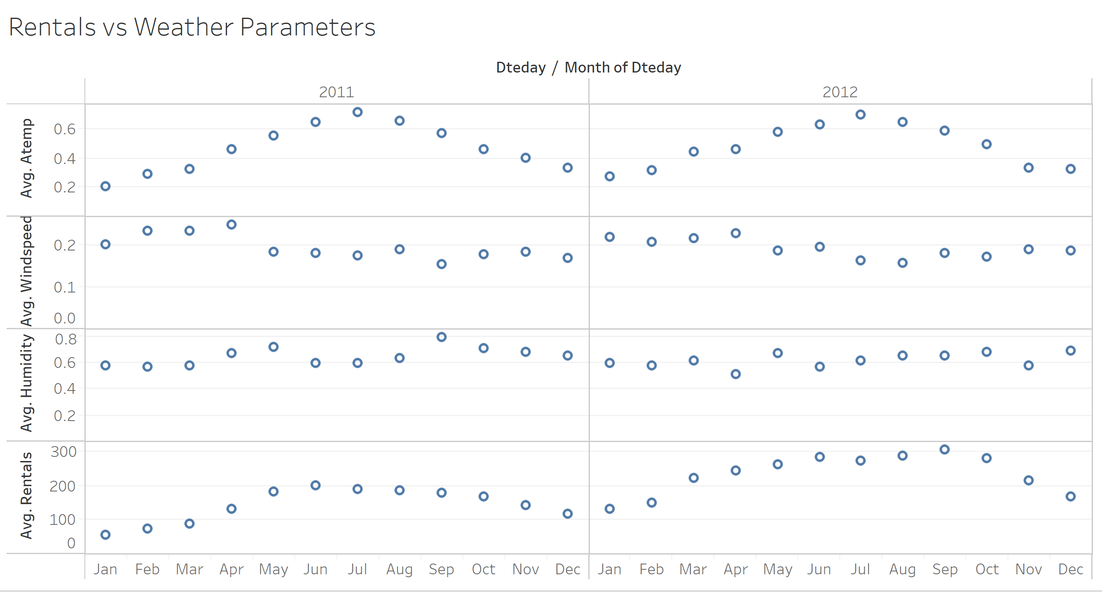
Rentals vs Weather Parameters
We here see the average rentals was dependent on the average temperature (Feeling temperature) and windspeed.
Higher temperatures and lower windspeed favored more rentals.
There seems to be no association between Humidity and Rentals.

Slide 12
Conclusion
Q1. How will you convert casual rides to registered rides?
Promotions and making contract with companies for commuting purpose of employees will increase the count of registered users for working days.
Providing offers for registered users during holidays.
Q2. How does the season and time affect the demand for bikes?
People seem to ride bikes more during Fall as the temperature ranges between 30 and 32 degree Celsius.
Moreover, Fall attracts more tourists hence increasing the bike rentals.
Clear and Partly Cloudy weather provides a pleasant and safe environment for riding bikes.
Q3. Why is there an increase of bike rentals over the two years?
People have become more environment, health and money conscious.
Since it is a safer option, people started preferring bike rentals.
Bike Rentals are a cheaper alternative for students as compared to other transportation services.

Slide 13
Thank You

